Slide 1

Benefits of Studying in USA
Parvez Alam, Ph.D
School of Biological Sciences
Indian Institute of Technology, New Delhi, India
Indo US- STEM Fellow 2016- 2017

Slide 2
Introduction
B.Sc. (Hons.) Chemistry- 2010, Aligarh Muslim University (Distinction)
M.Sc. Biotechnology- 2012, Aligarh Muslim University (Distinction)
Ph.D Biotechnology Aligarh Muslim University, India in association with The Ohio State University, USA, 2017. GYTI (Gandhian Young Technological Innovation Award)- 2016 for Ph.D work (INR 15,00000 for one year)
Till date I have published more than 40 research publications with overall 778 citations
Alumnus of the Indo-US STEM program 2016- 2017

Slide 3
Research work carried out at OSU
While working at OSU under the supervision of Prof. Christopher Jaroniec, I studied effect of Cu (II) binding on the aggregation behavior of Human prion protein (HuPrP 23- 144)
HuPrP23-144 aggregation is associated with a heritable amyloid angiopathy
Cu (II) inhibits the aggregation of HuPrP 23- 144 and further it changes the morphology of aggregates significantly
Still work is in progress, we are trying out figure out how copper modulate the amyloid core region of protein
If everything goes well this could be a “potential discovery” as Chris said.

Slide 4


Hocking hill station visit
Niagara falls visit

Slide 5

Why to study in USA?
Top Ranking Universities
Academic flexibility
Funding opportunities
Global contacts
Well rounded personality
Travel the world

Slide 6
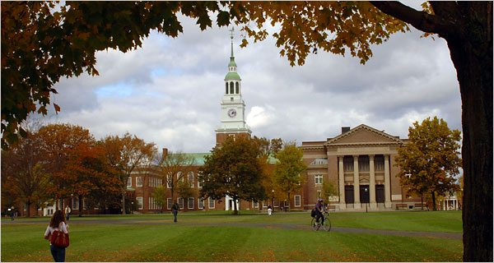
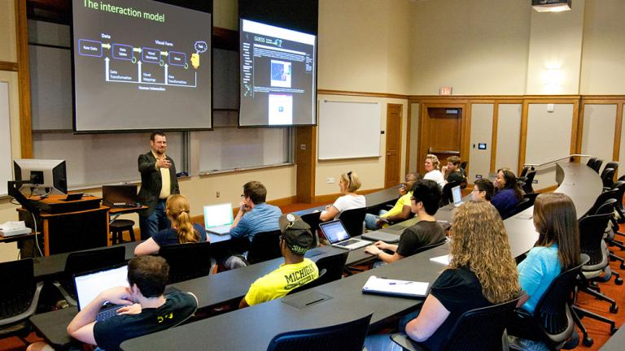
Top Ranking Universities
According to the latest reports by various highly acclaimed ranking agencies such as the QS World, USA has emerged as a leading country known for its quality education
Out of top 100 world universities around 30 are from US itself
As per QS ranking 2018 only three Indian institution are in Top 200. IIT Delhi- 172, IIT Bombay- 179 and IISc Bangalore- 190
World class faculty
Most professors in the US universities are well trained and have a strong background of academic and years research of experience
The professors enjoy introducing new approaches to teaching and research methodologies and always encourage their students to bring out their best
Notes:
1 MIT, 2 Stanford 3 Harvard 4 Caltech 5 Cambrdige

Slide 7

Academic flexibility
The USA education system is flexible in terms of choice of courses within a college or university. During the course of study, a student can transfer from one course/stream to another.
This diversity offers students options to specialize in a variety of academic disciplines and even gain employment training

Slide 8

Funding opportunities
The education definitely falls in the category of value for your money. USA education is the best investment for the future
A wide spectrum of tuition fees, accommodation options & financial help from the institutions in the form of scholarships, fee waivers, aids, etc makes USA education affordable
Khorana Program- Summer Internship for Indian students in US Universities
Fulbright fellowship- Visiting and full Ph.D fellowship
Various other Ph.D and post doctoral fellowships supported by Indian and US Government

Slide 9

Global contacts
Since US Education is very popular among all international students, staying on campus helps students in making new friends from all over the world, learn a lot about other cultures and communities and enrich their experiences
For many international students, living in a hostel/dormitory with other university students gives them an opportunity to meet new people from different backgrounds and make lifelong bonds. When you return home with US qualifications, you boast of your international links
"In diversity there is beauty and there is strength”
Maya Angelou

Slide 10

Well rounded personality
US education system encourages holistic development of the students. Prime focus is on the prolific development of the students through practical exposure and application based academics
US provides both a conducive and challenging environment, that makes a student much stronger individual and an extremely independent person
The exposure to the US, one of the most culturally diverse and inclusive societies in the world, along with its vibrant college campuses, is seldom replicated in those of any other countries.
Notes:
The astonishing and intimidating diversity makes students highly adaptable and aware, a few personality traits that later becomes a major asset for being holistically successful in the fast paced, globalized world.

Slide 11

Get international experience for your CV
Being aware of the fact that US universities have a great reputation and are well-known for the quality of their education, it’s not surprising that companies are excited to welcome young people with US degrees
By studying in the US, you will make the first step towards a successful international career. During your student years, you will also have the opportunity to gain experience in your field of study through the Optional Practical Training program
Studying abroad at a US university is perfect preparation for an international workplace, giving you the international experience which is sought by many employers

Slide 12

Travel the world
Travelling Abroad for a holiday from India always looks like an expensive affair, but when you are living abroad and earning in a foreign currency, making holiday plans to exotic locations will be a lot easier
Countries like UK, US are portals to get easy access to some of the most exiting travel destinations
“sair kar duniyā kī ġhāfil zindagānī phir kahāñ
zindagī gar kuchh rahī to ye javānī phir kahāñ”
Mirza Ghalib
Notes:
Lets explore this world while we can, Who knows how long we may live
And even if we are alive, how long are we going to remain young

Slide 13
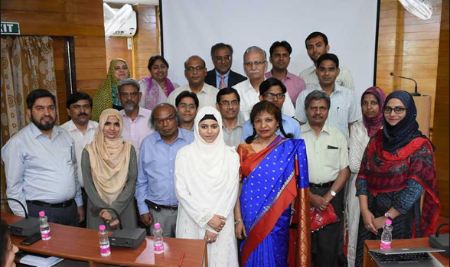




Acknowledgements
Prof. Anil Pradhan, Prof. Sultana Nahar and Prof. Karen Irving (OSU)
Ph.D mentors (Prof. Rizwan Khan- AMU and Prof. Chris Jaroniec- OSU)
STEM fellows (Swaleha, Sabiha and Taqseer)

Slide 14
Thank You
Tu Raaze- Kun Fakan h Apni Aankho Par Ayan Ho Ja
Khudi Ka Raazdan Ho Ja Khuda Ka Tarjuma Ho Ja
Allama Iqbal

